Slide 1
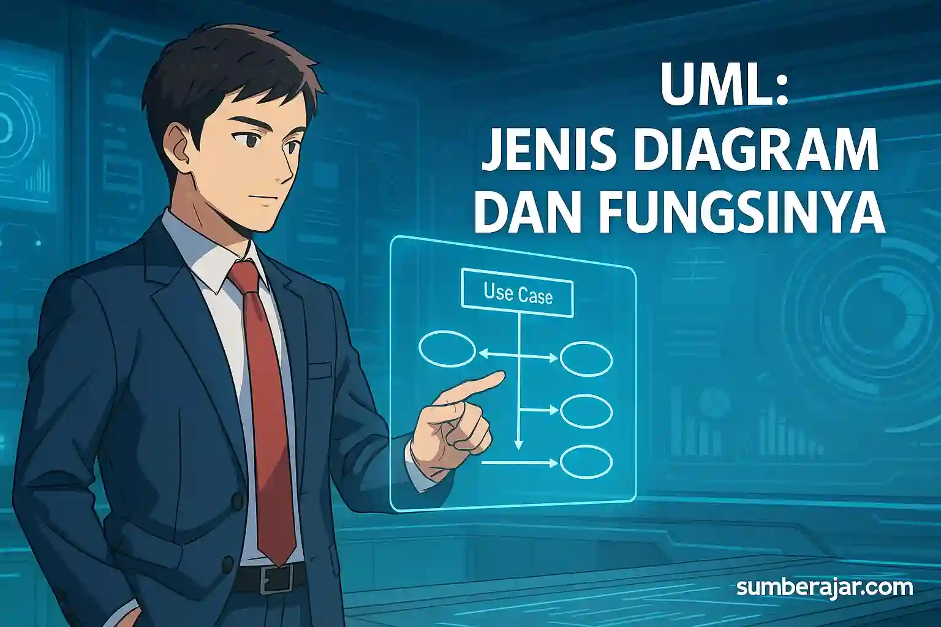
UML diagrams
Student work :
Mohammed alyahya
Ahmed alhajry
Hassan alabdulal
Badr Almanea
Doctor of course : Mohammed Elfaki

Slide 2
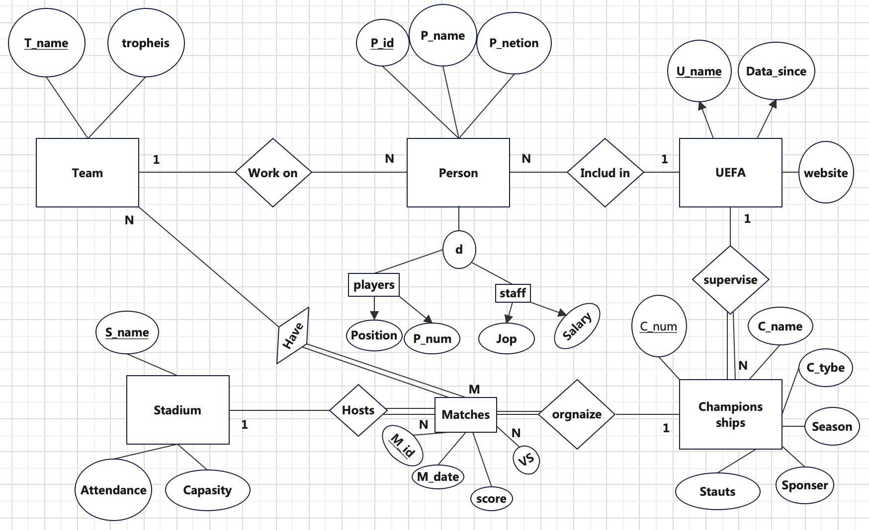
EER diagram

Slide 3
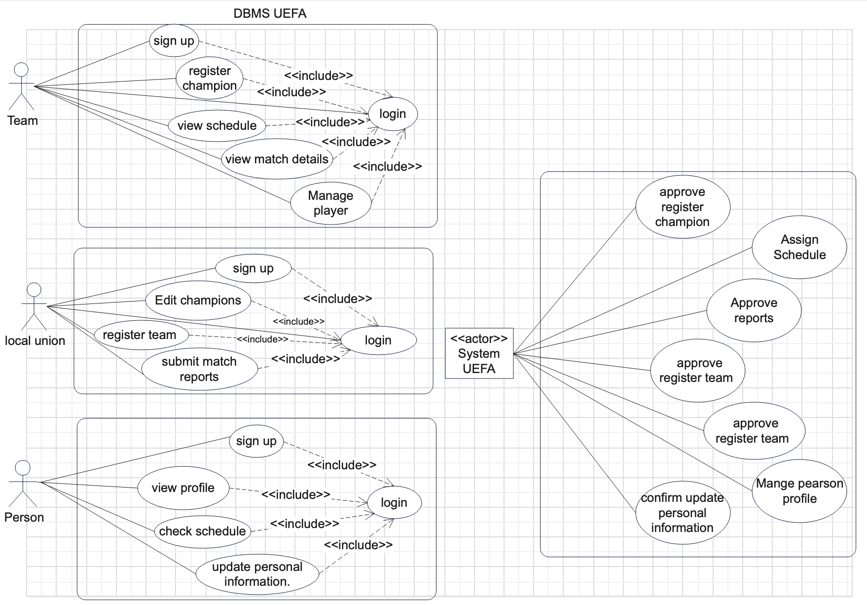
Use case diagram

Slide 4
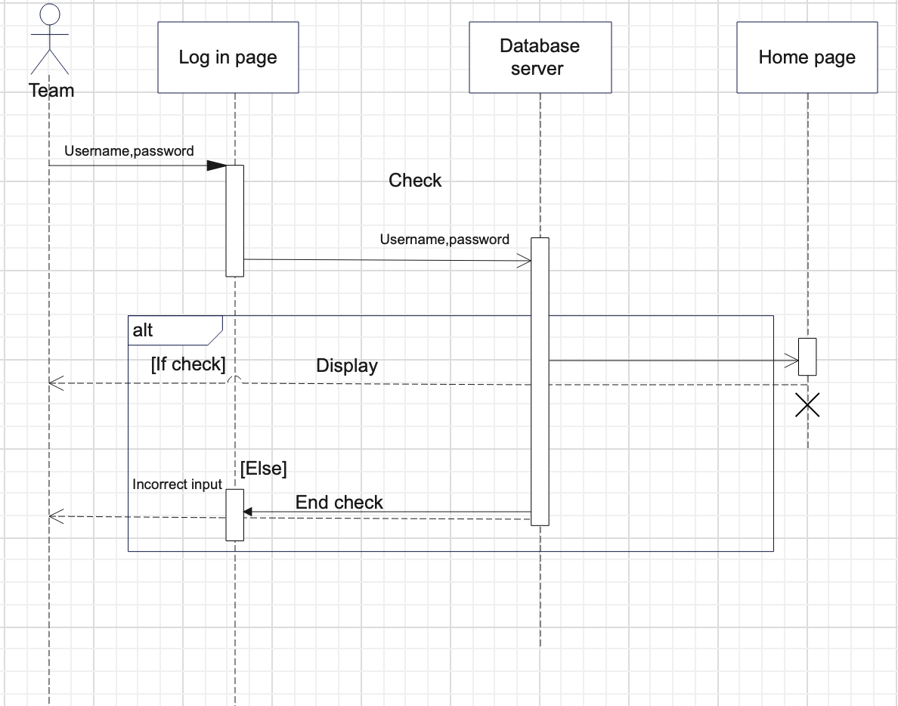
sequence Diagram

Slide 5
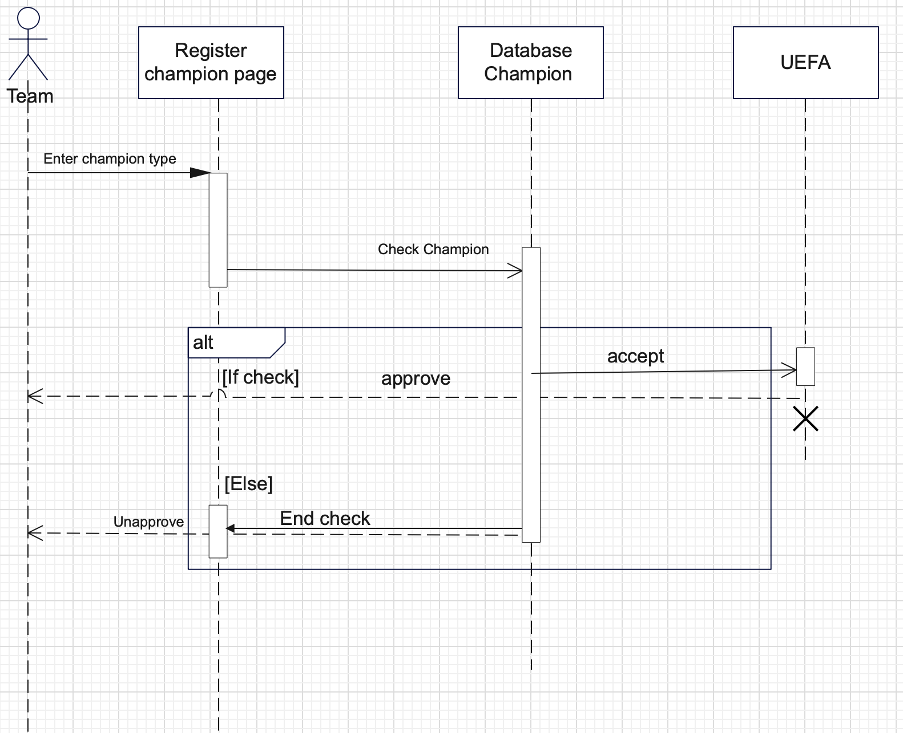
sequence Diagram

Slide 6
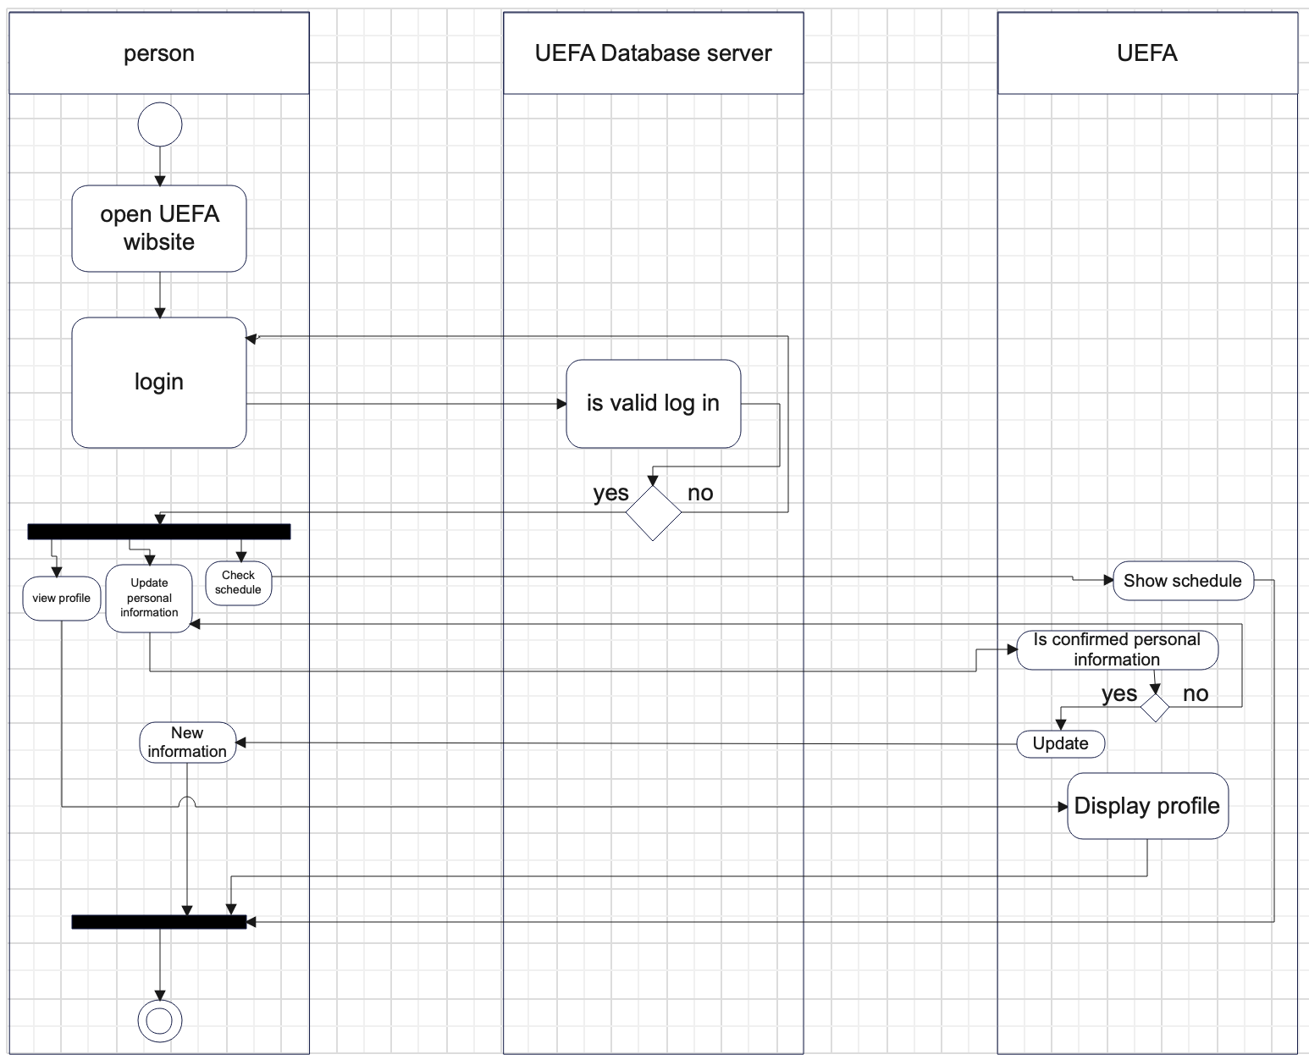
Swimlane diagram

Slide 7
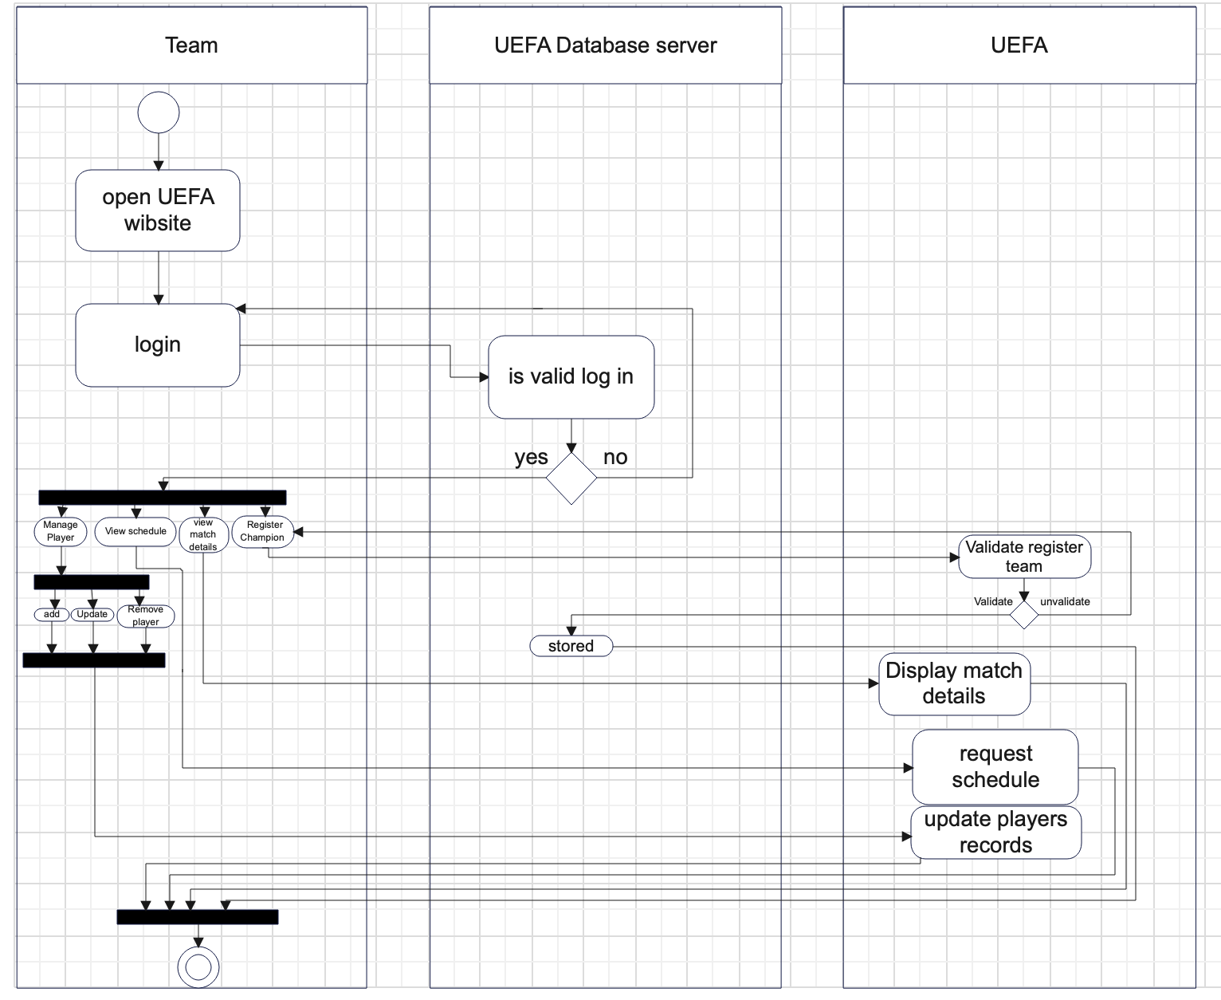
Swimlane diagram

Slide 8
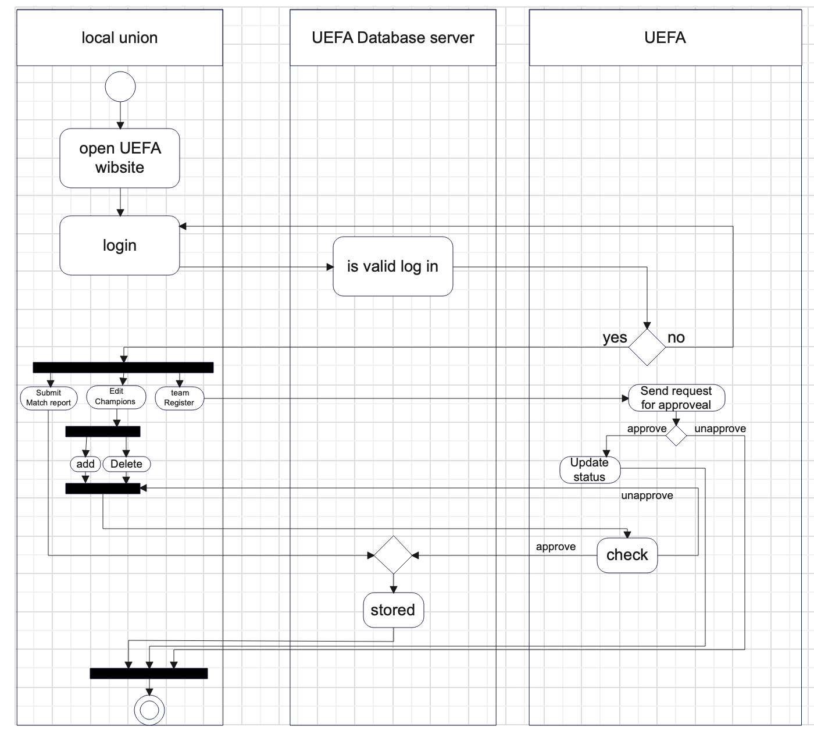
Swimlane diagram

Slide 9
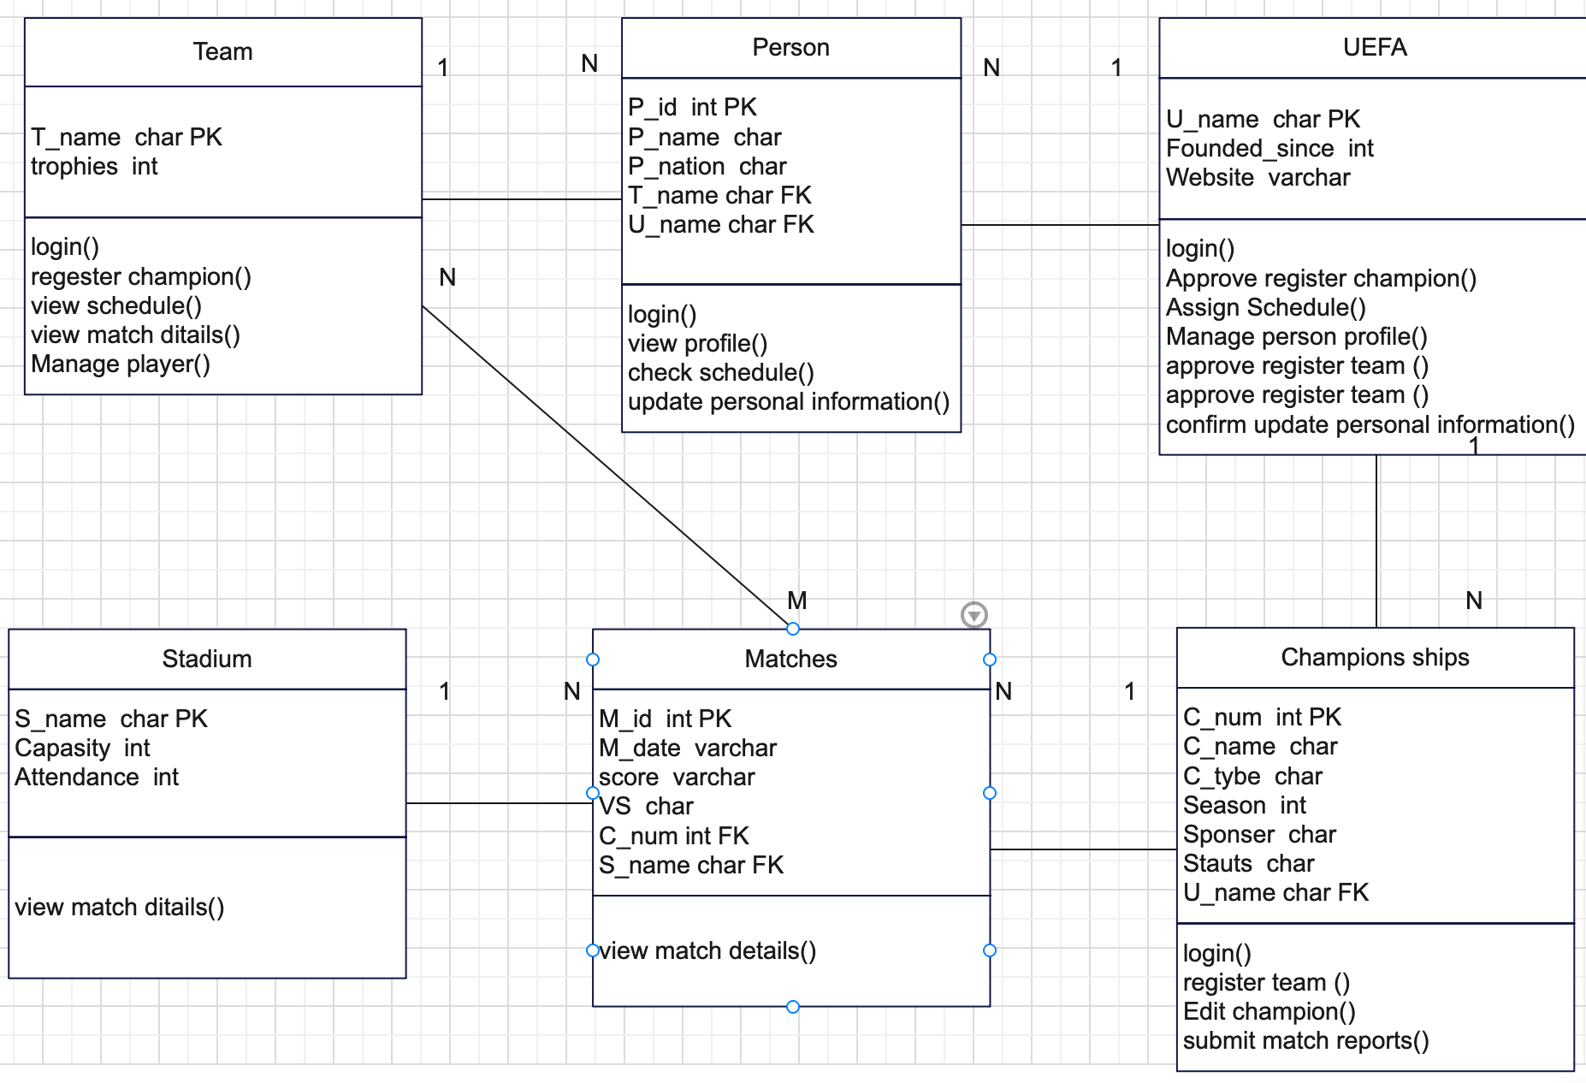
Classes diagram

Slide 10
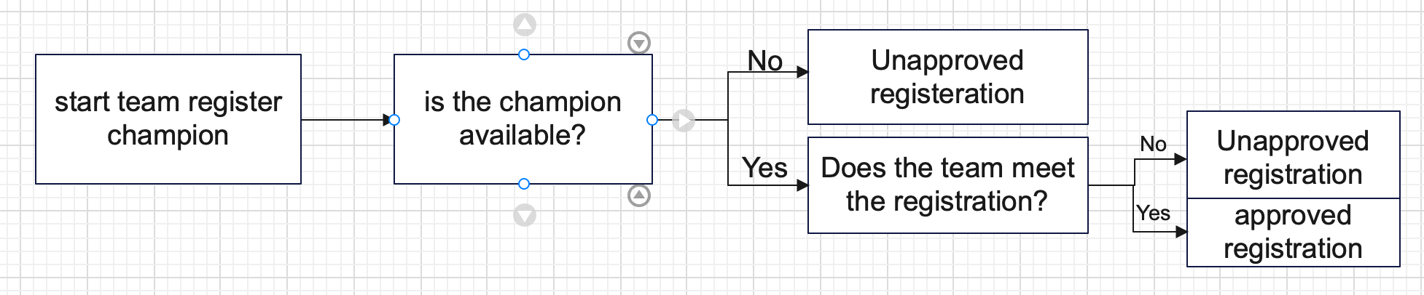
Decision three

Slide 11
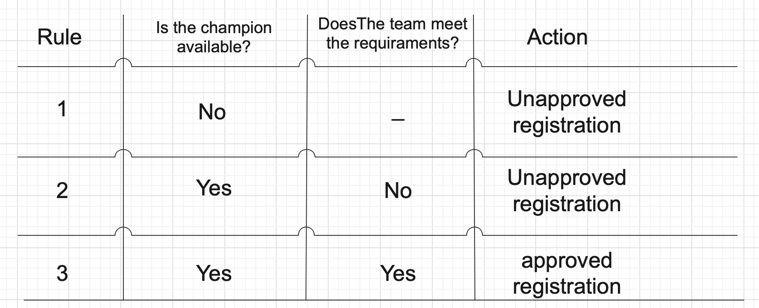
Decision table

